Slide 1
Matrix Algebra
Master MLDS - 2018/2019
Université Paris Descartes
Lazhar.labiod@parisdescartes.fr
Université Paris Descartes
Notes:
Master ID
Février 2006
M. Nadif Université de Metz

Slide 2
Matrix Algebra
Definitions
Operations

Slide 3
What is it?
Matrix algebra is a means of making calculations upon arrays of numbers (or data).
Most data sets are matrix-type

Slide 4
Why use it?
Matrix algebra makes mathematical expression and computation easier.
It allows you to get rid of cumbersome notation, concentrate on the concepts involved and understand where your results come from.

Slide 5
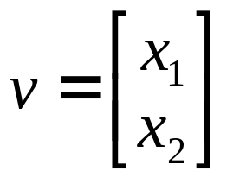
Vectors
Vector: N x 1 matrix
dot product and magnitude defined on vectors only
x₂
x₂
x₂
a
a+b
a
a-b
v
b
b
x₁
x₁
x₁
vector addition
vector subtraction

Slide 6
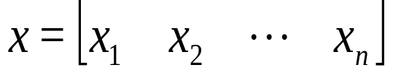
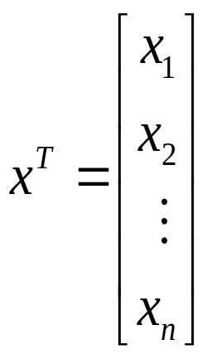
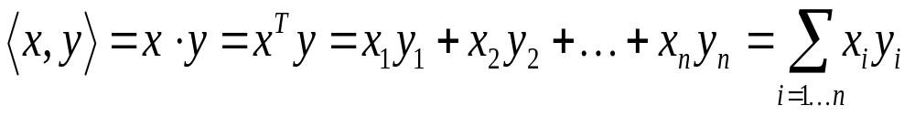
More on Vectors
n-dimensional row vector
Transpose of row vector is column vector
Vector product (or inner or dot product)

Slide 7
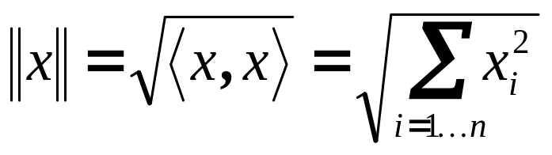
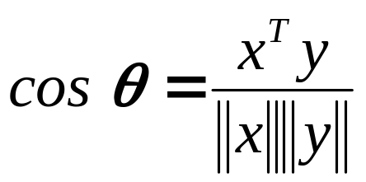



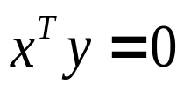
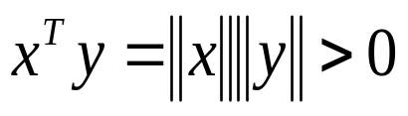
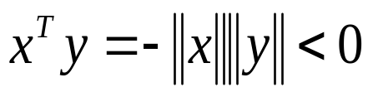

More on Vectors
Euclidian norm or length
If ||x|| =1 we say x is normalized or unit length
angle q between vectors x and y :
inner product captures direction relationship
y
y
y
x
x
x

Slide 8
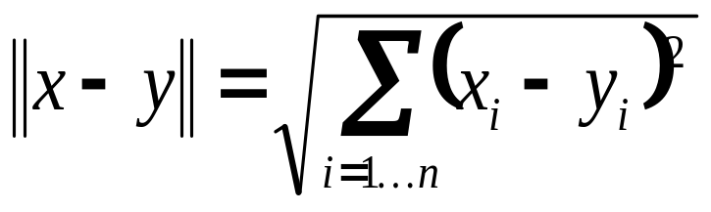
More on Vectors
Vectors x and y are orthonormal if they are orthogonal and ||x|| = ||y|| =1
Euclidian distance between vectors x and y
x
x-y
y

Slide 9
Linear Dependence and Independence
Vectors x₁, x₂,…, x_{n} are linearly dependent if there exist constants α₁, α₂,…, α_{n} s.t.
  α₁x₁+ α₂x₂+…+α_{n}x_{n} = 0
  α_{i} ≠ 0 for at least one I
Vectors x₁, x₂,…, x_{n} are linearly independent if α₁x₁+ α₂x₂+…+α_{n}x_{n} = 0 ⇒ α₁ = α₂=…= α_{n}= 0

Slide 10
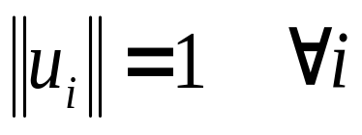
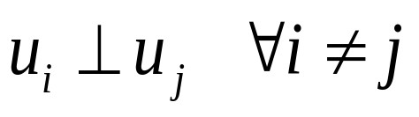
Vector Spaces and Basis
The set of all n-dimensional vectors is called a vector space V
A set of vectors {u₁,u₂,…, u_{n} } are called a basis for vector space if any v in V can be written as v = α₁u₁+ α₂u₂+…+α_{n}u_{n}
u₁,u₂,…, u_{n} are independent implies they form a basis, and vice versa
u₁,u₂,…, u_{n} give an orthonormal basis if

Slide 11
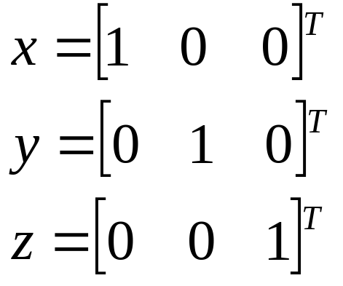
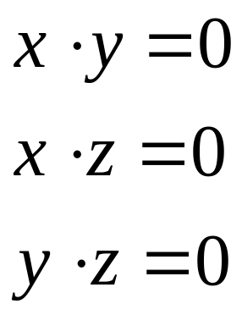
Orthonormal Basis
x, y,…, z form an orthonormal basis

Slide 13
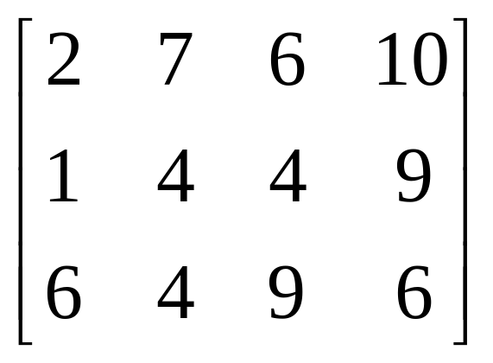
What is a Matrix?
A matrix is a set of elements, organized into rows and columns
rows
example 1
columns
example 2
example 3
feature 1
feature 2
feature 3
feature 4

Slide 14
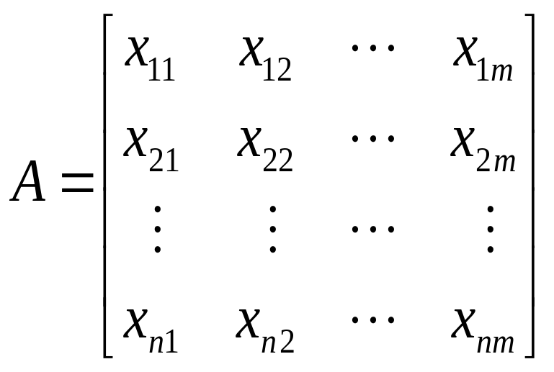
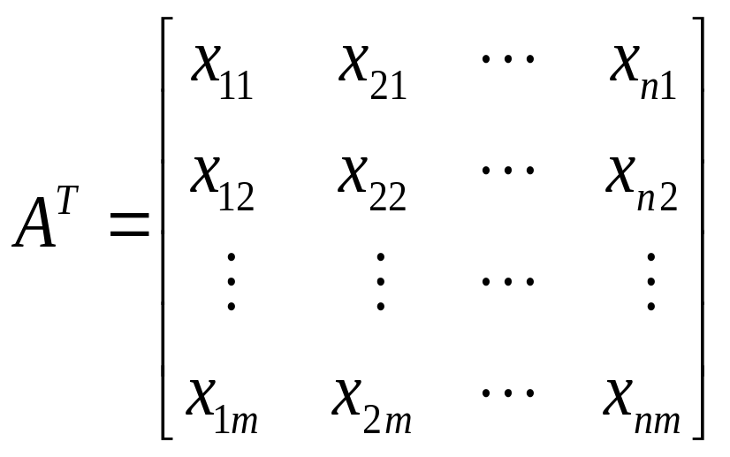
Matrix Transpose
T
n by m matrix A and its m by n transpose A

Slide 15
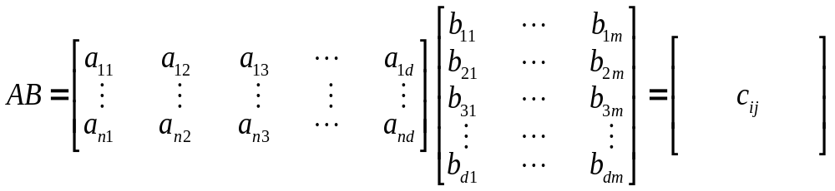
Matrix Product
c_{ij} = ⟨a^{i}, b_{j}⟩
a^{i} is row i of A
b_{j} is column j of B
# of columns of A = # of rows of B
even if defined, in general AB ≠ BA

Slide 16
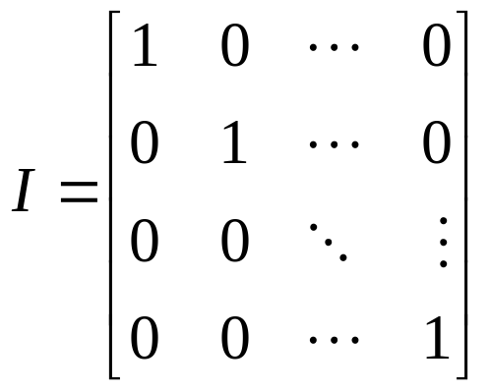
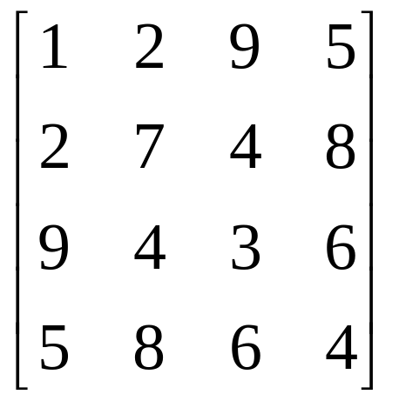
Matrices
Rank of a matrix is the number of linearly independent rows (or equivalently columns)
A square matrix is non-singular if its rank equal to the number of rows. If its rank is less than number of rows it is singular.
Identity matrix
AI=IA=A
T
Matrix A is symmetric if A=A

Slide 17
Matrices
-1
Inverse of a square matrix A is matrix A s.t. AA = I
-1
If A is singular or not square, inverse does not exist
Pseudo-inverse A is defined whenever A A is not singular (it is square)
  A = (A A) A
  AA =(A A) AA=I
T
T
-1
T
T
-1
T

Slide 18
Matrix Operations
Transposition
Addition and Subtraction
Multiplication
Inversion

Slide 19
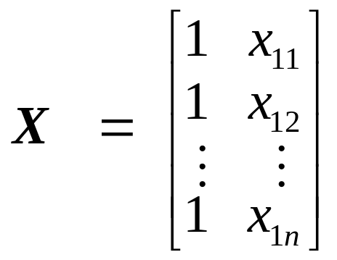
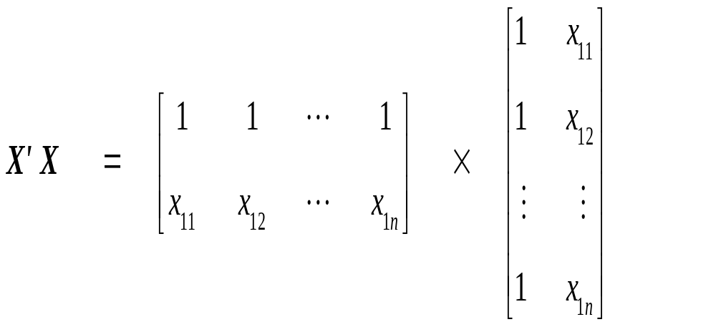
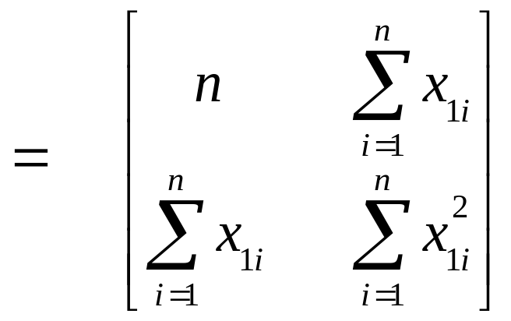
A popular matrix: X'X

Slide 20
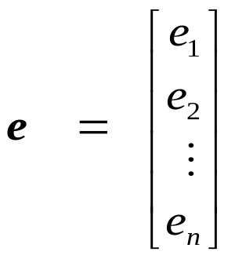
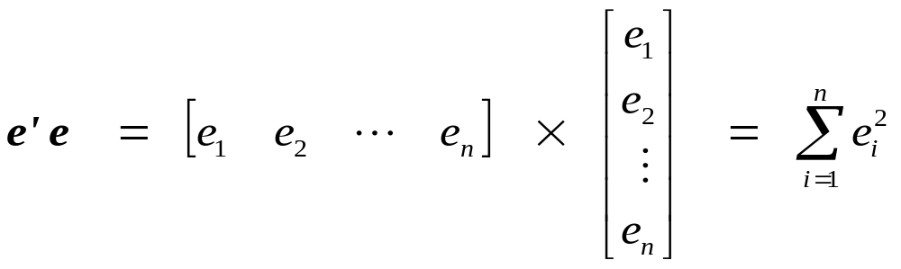
Another popular matrix: e'e

Slide 21
Special matrices
There are a number of special matrices
  Diagonal
  Null
  Identity

Slide 22
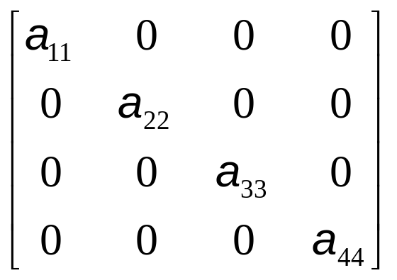
Diagonal Matrices
  A diagonal matrix is a square matrix that has values on the diagonal with all off-diagonal entities being zero.

Slide 23
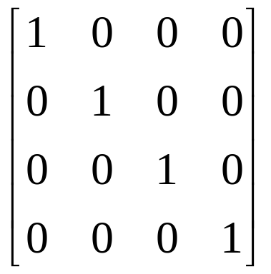
Identity Matrix
An identity matrix is a diagonal matrix where the diagonal elements all equal one.
I =
A × I = A

Slide 24
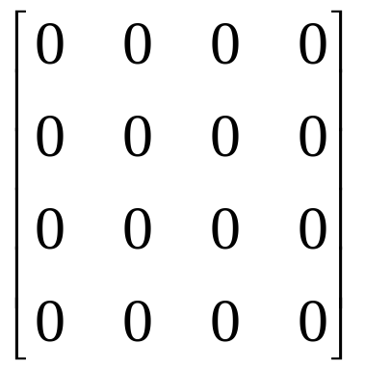
Null Matrix
A square matrix where all elements equal zero.

Slide 25
The Determinant of a Matrix
The determinant of a matrix A is denoted by |A| (or det(A)).
Determinants exist only for square matrices.
They are a matrix characteristic, and they are also difficult to compute

Slide 26
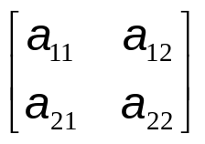
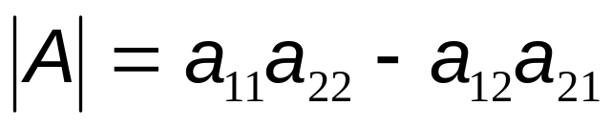
The Determinant for a 2x2 matrix
If A =
Then

Slide 27
Properties of Determinates
Determinants have several mathematical properties which are useful in matrix manipulations.
  1 |A|=|A'|.
  2. If a row or column of A = 0, then |A|= 0.
  3. If every value in a row or column is multiplied by k, then |A| = k|A|.
  4. If two rows (or columns) are interchanged the sign, but not value, of |A| changes.
  5. If two rows or columns are identical, |A| = 0.
  6. If two rows or columns are linear combination of each other, |A| = 0

Slide 28
Properties of Determinants
  7. |A| remains unchanged if each element of a row or each element multiplied by a constant, is added to any other row.
  8. |AB| = |A| |B|
  9. Det of a diagonal matrix = product of the diagonal elements

Slide 29
Rank
The rank of a matrix is defined as
rank(A) = number of linearly independent rows
= the number of linearly independent columns.
A set of vectors is said to be linearly dependent if scalars c₁, c₂, …, c_{n} (not all zero) can be found such that
c₁a₁ + c₂a₂ + … + c_{n}a_{n} = 0

Slide 30
For example,
a = [1 21 12] and b = [1/3 7 4] are linearly dependent
A matrix A of dimension n × p (p < n) is of rank p. Then A has maximum possible rank and is said to be of full rank.
In general, the maximum possible rank of an n × p matrix A is min(n,p).

Slide 31
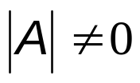
The Inverse of a Matrix (A⁻¹)
For an n × n matrix A, there may be a B such that AB = I = BA.
The inverse is analogous to a reciprocal
A matrix which has an inverse is nonsingular.
A matrix which does not have an inverse is singular.
An inverse exists only if

Slide 32
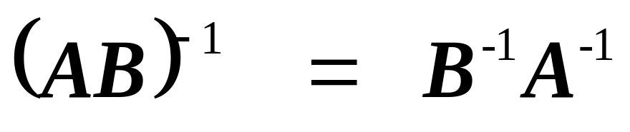
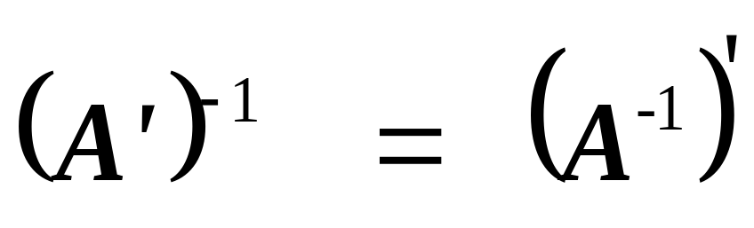
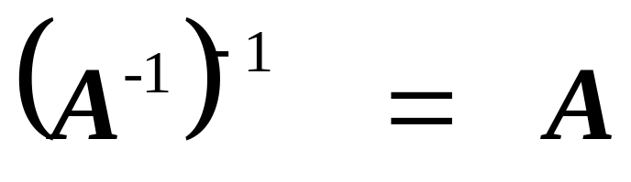
Properties of inverse matrices

Slide 33
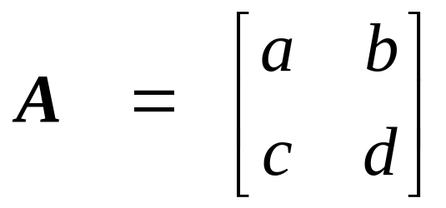
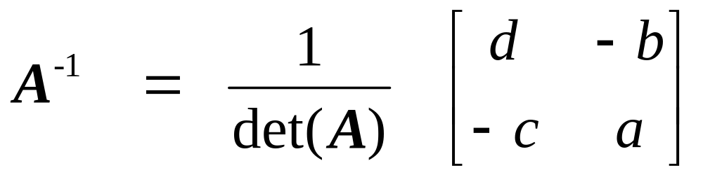
How to find inverse matrixes? determinants? and more?
If and |A| ≠ 0
Otherwise, use R or Python, an easier way

